Slide 1


Slide 2
UIDAI HACKATHON
Team ID: UIDAI_2155

Slide 3
PROBLEM STATEMENT

Slide 4
PROBLEM STATEMENT

Slide 5

The Aadhaar ecosystem currently relies on volume-based reporting that creates a "false equivalence" between disparate operational tasks. This presents the issue that, by treating a labor-intensive fresh enrolment as essentially equivalent to a fast demographic update, the current model disguises actual operator workloads, as well as important information on migration. There is a lack of granularity, which is evidenced by resource asymmetry, where hardware allocation does not take into consideration complexity, as well as an ineffective reactive approach in dealing with fraud as a post-facto issue.

Slide 6
DATASET USED

Slide 7
1
Tracks fresh Aadhaar generation to establish a baseline for "Growth" and population saturation.
To move beyond volume-based reporting, we consolidated three distinct UIDAI datasets into a single master dataset totaling 2.9 million records from March to December 2025. This unified data captures the complete resident lifecycle:
ENROLMENT DATA
4
2
DEMOGRAPHIC UPDATES
Records address and name changes, acting as the heartbeat of "Migration" to identify transit hubs.
3
Monitors mandatory updates for children, serving as the primary indicator for Compliance.
BIOMETRIC UPDATES

Slide 8
METHODOLOGY

Slide 9
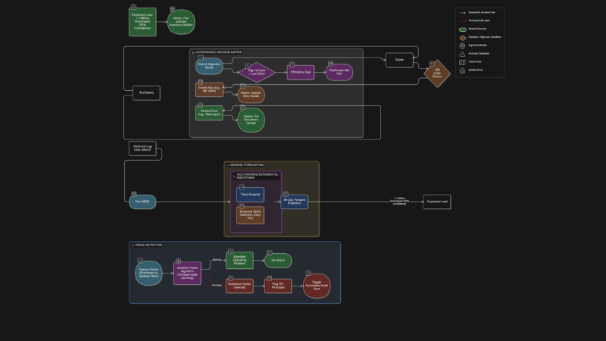
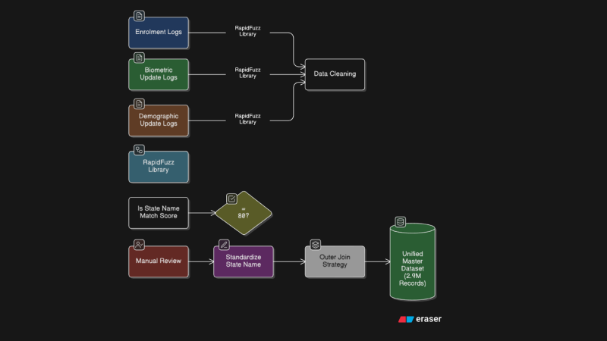
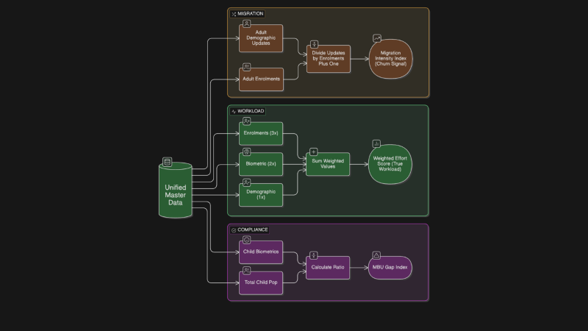



Slide 10
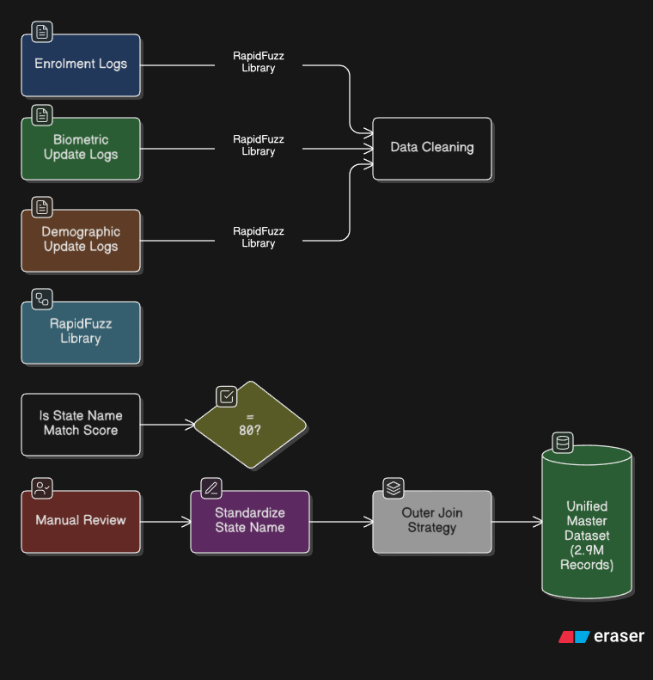

Slide 11
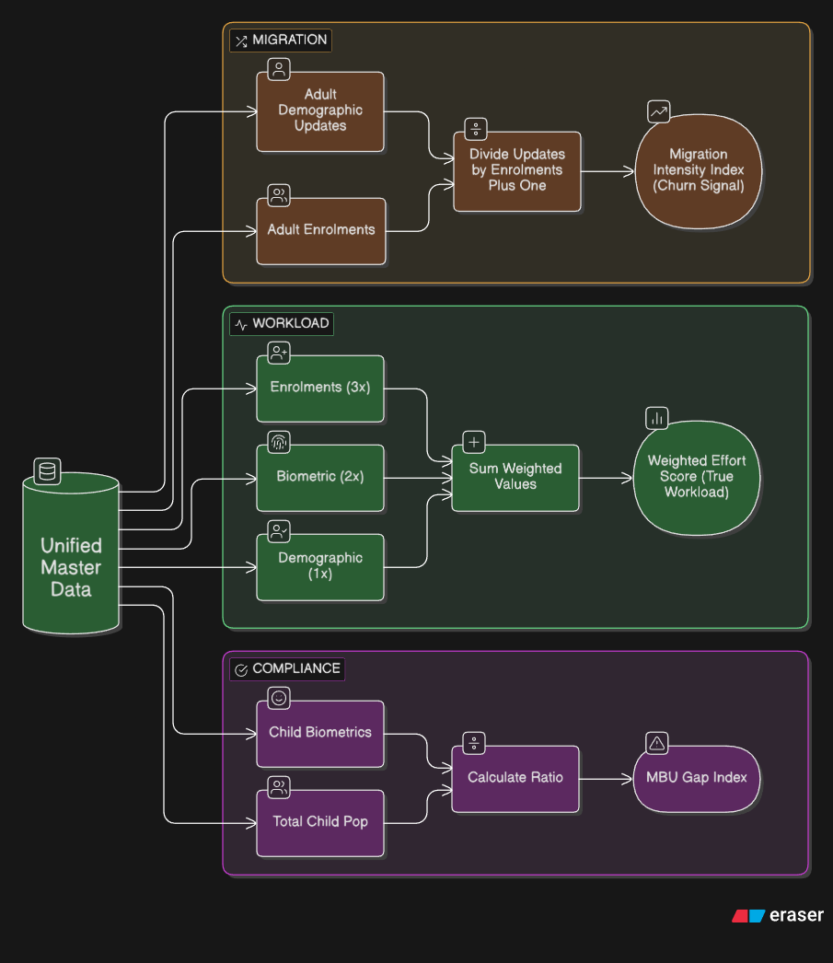

Slide 12
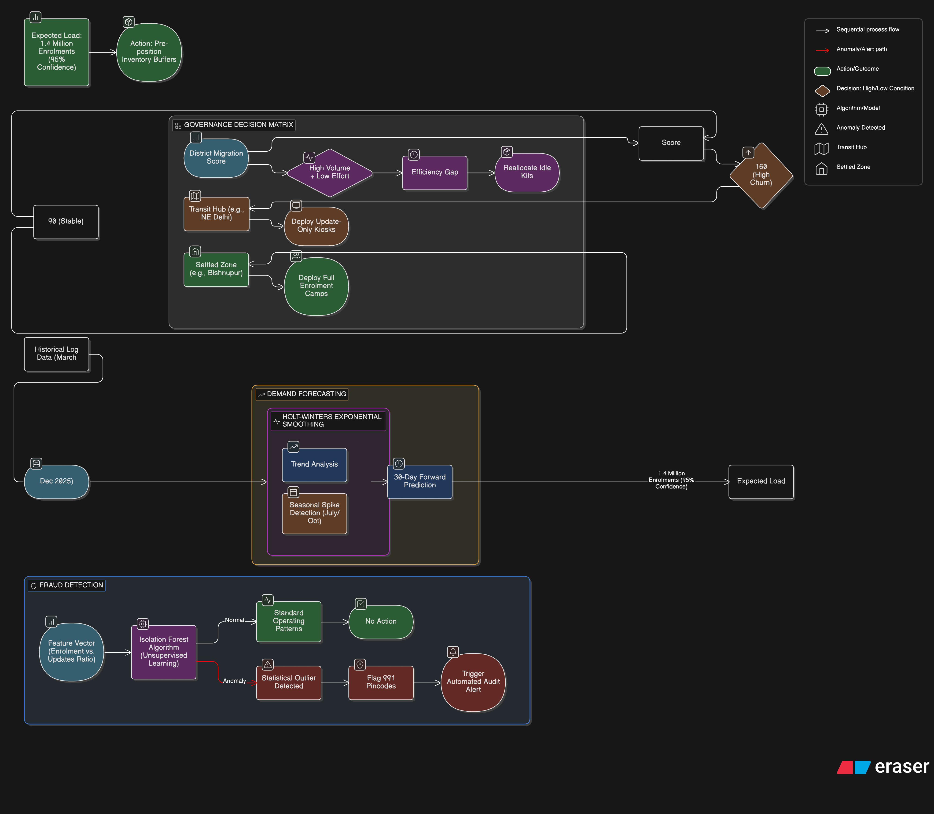

Slide 13
FEATURE EXTRACTION

Slide 14



Slide 15
PARETO ANALYSIS (80/20 RULE)

Slide 16
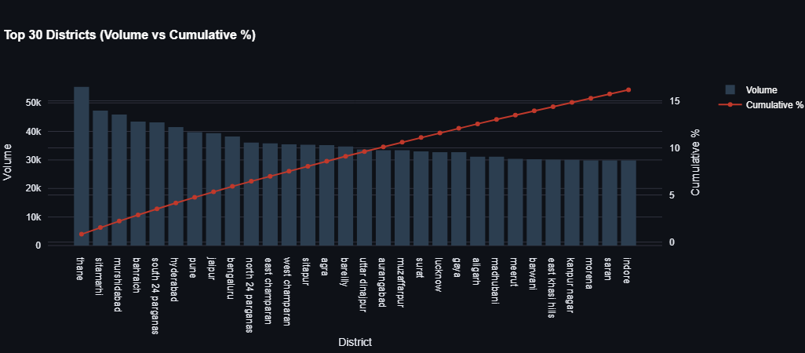
From our analysis, we found a huge operational skew wherein the top 20% of districts drive 59.6% of the entire nation's enrolment volume. Essentially, the operational stability of only a few high-volume drivers such as Thane, Sitamarhi, and Murshidabad ensures operational stability for a majority of the national ecosystem.

Slide 17
MIGRATION DYNAMICS (THE ’CHURN’ MAP)

Slide 18
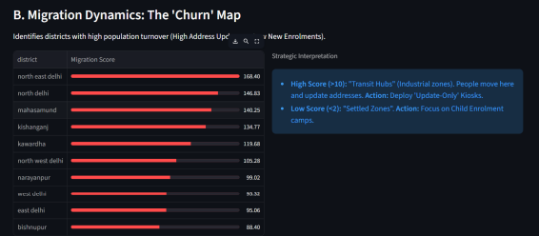
Our analysis was able to successfully differentiate between Transit Hubs and Settled Zones by determining a Migration Intensity Score for every district.
A high "Migration Intensity Score" revealed Transit Hubs like North East Delhi (Score: 168.40).
Settled Zones like Bishnupur (Score: 88.40) are revealed by a low Migration Intensity Score.
This differentiation is vital as well because Transit Hubs require automated Self-service kiosks to decongest queues, whereas Settled Zones require Full Enrolment camps to capture new population growth

Slide 19
OPERATIONAL EFFICIENCY GAP

Slide 20
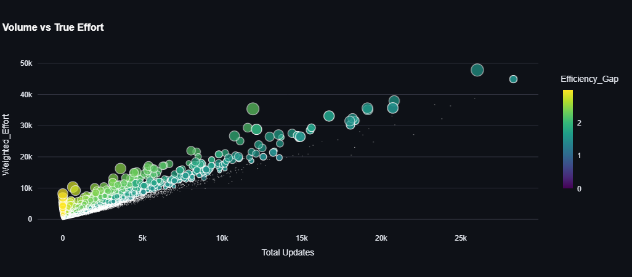
The prevailing reporting model encourages a questionable high volume by treating labour-intensive fresh enrolments as equivalent to fast address updates.
Utilizing our "Weighted Effort" score, with a 3.0 level of difficulty weight used for fresh enrolments as opposed to merely 1.0 weight utilized in demographic updates, we discovered an efficiency gap.
A number of districts that may look high volume on paper, in fact, work as low-intensity update operations.
Notes:
This allows UIDAI to cease over-financing those busy-looking districts and target those districts with real "high-effort" fresh enrolment backlogs.

Slide 21
STRATEGIC STATE ARCHETYPES: DIVERGENT OPERATIONAL BEHAVIORS

Slide 22
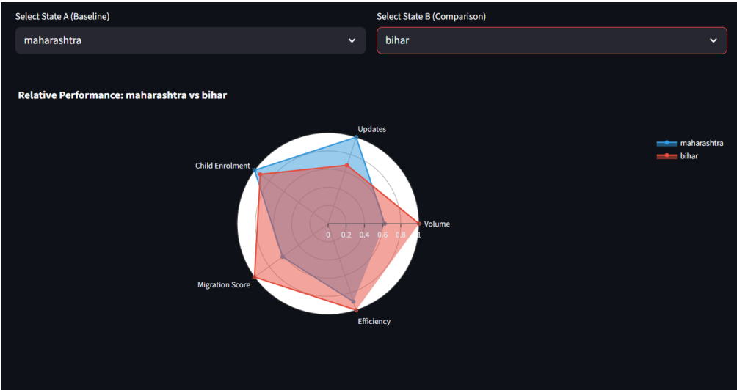
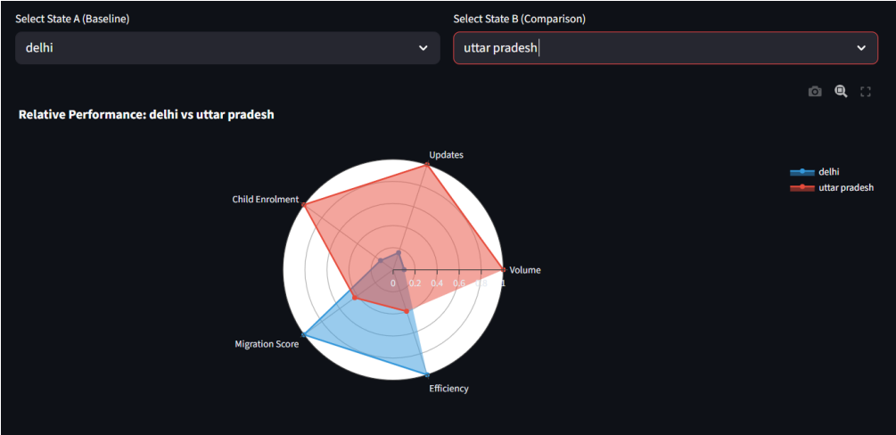
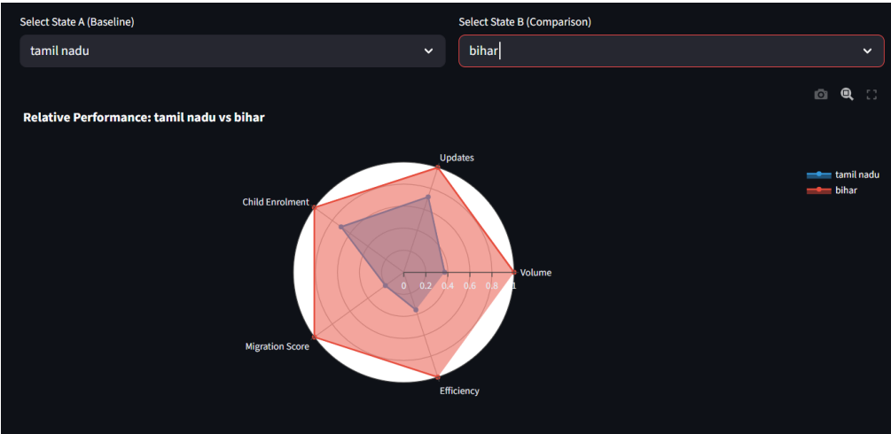
Our analysis demonstrates that the Aadhaar ecosystem is not a monolithic entity but rather comprises distinct "Governance Archetypes" that require tailored operational strategies . By contrasting state-level data, we identified "Migration Corridors," where destination states like Maharashtra function as industrial sinks driving high update demand, while source states like Bihar remain focused on fresh enrolment growth . We also distinguished "Mature Economies" like Tamil Nadu, which prioritize maintenance efficiency, from "Growth Economies" that are still in the acquisition phase . This variance confirms that a unified national policy is less effective than targeted, archetype-specific interventions .

Slide 23
AI DIAGNOSTICS: THE 991 ANOMALIES

Slide 24
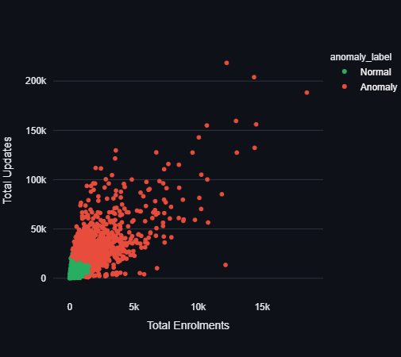
Our Anomaly Detection Engine employed an "Isolation Forest” machine learning algorithm. This algorithm was able to successfully flag specific pin codes as anomalies (991 specific pin codes in our data sets). This was not simply due to the higher volumes within the data sets but, the ratios were mathematically and statistically impossible under normal circumstances, indicating potential fraudulent practices to update user details in bulk

Slide 25
TEMPORAL DATA ANALYSIS

Slide 26
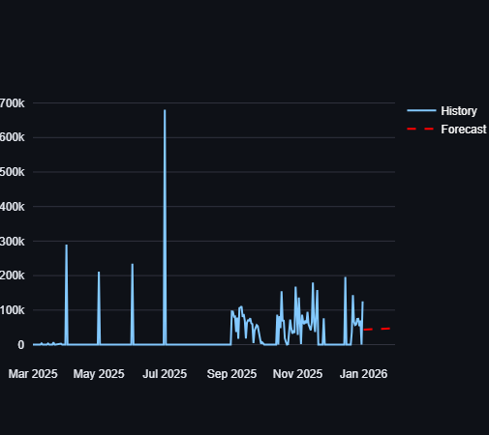
Our system will make operations predictive instead of reactive by employing the Holt-Winters Exponential Smoothing algorithm.
This model takes critical seasonal variances into consideration-for instance, the sharp update spikes seen in July and October 2025 linked to school admissions-to forecast demand with very high precision.

Slide 27
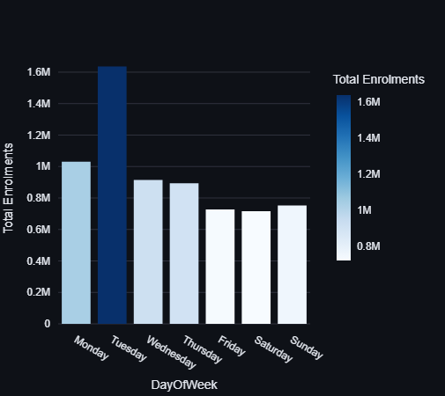
Our analysis of temporal data reveals distinct behavioral patterns that govern ecosystem activity. Weekly cycles show a massive front-loading of effort, with Mondays and Tuesdays consistently recording the highest volumes as centers process the weekend backlog

Slide 28
